Slide 1

Blood Bank Application
Utsav Patel
Sanath Tulli
Mohaiminul Islam
Parmeet Singh

Slide 2
Objective of project
Maintain a directory of registered donors.
Schedule a blood donation Time.

Slide 3
Features of the project
Login Page
Home page
Navigation bar menu.
New User registration page.
User details page.
About us Page.

Slide 4
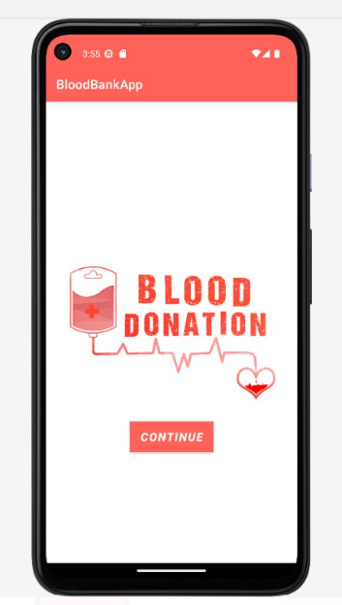
This is the Application starting page.
We used our simple xml design for creating the page.
We

Slide 5
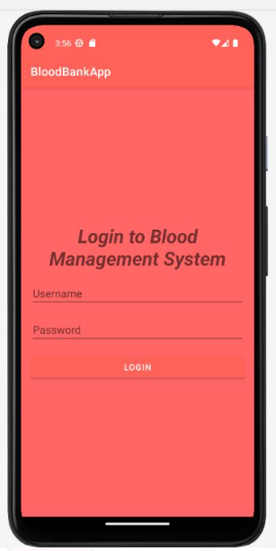
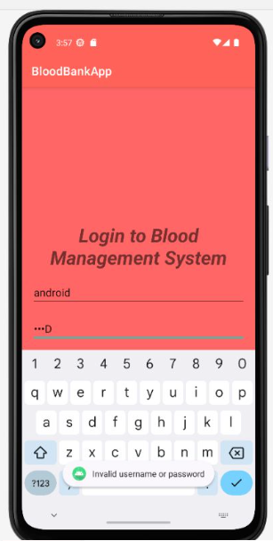
Login page.
User can log in to the app using their username and password.

Slide 6
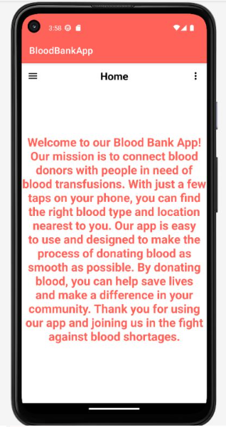
Home page.
It has the simple introduction about our created page.

Slide 7
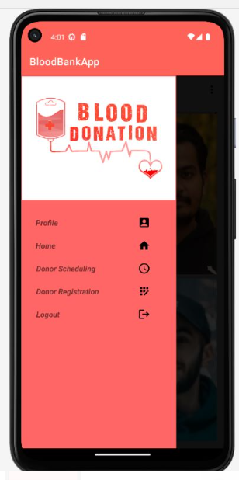
Navigation menu page.
It is a left slide navigation menu page from where user can visit different section of the app.

Slide 8
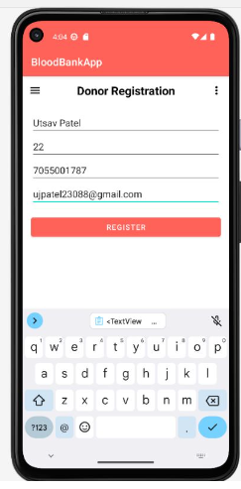
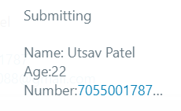
Registration page.
It is user registration page from where user can register for blood donation.

Slide 9
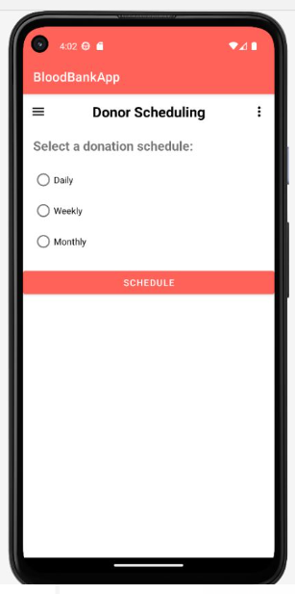
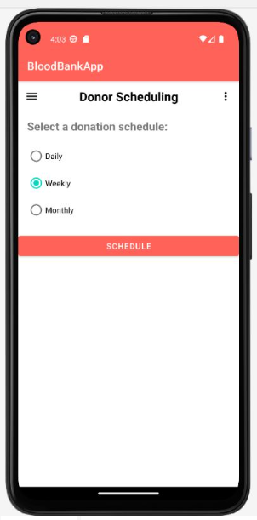
Scheduling page.
Here we can schedule donor’s scheduling routine for donation blood.

Slide 10
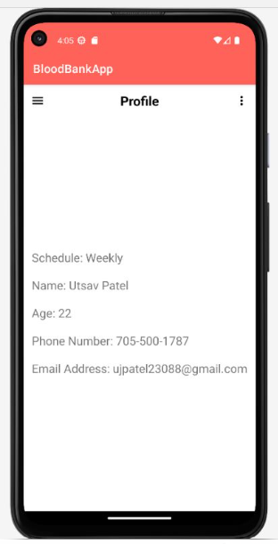
User Detail page.
Here we can see the information of a potential donor with their contact information.

Slide 11
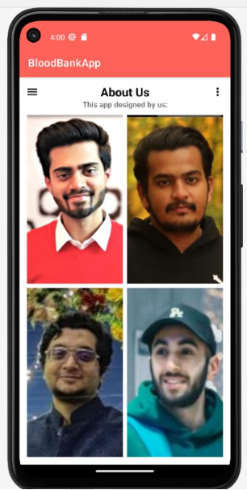
About us.
Here we have the app designers images.

Slide 12
Architecture of the app
Front end is rendered by Xml.
Back end is rendered by Android x.
Database for storing user data is Firebase.

Slide 13
Future Scope of the project
The project scope can be spanned further by adding multiple pages such as
Blood storage page – to show blood blanks and hospitals nearby using google map api.
Blood request page – A user can request for blood request using the app.
Monthly statistical page – To show the analytics of user when they will be eligible for next donation.
Data visualization page – Using historical data to analyze and visualize future trends.
FAQ page – Where a user can find frequently ask questions and answers and comment their suggestions.

Slide 14
Thank you

